Slide 1

Lecture Slides
Elementary Statistics
Twelfth Edition
and the Triola Statistics Series
by Mario F. Triola

Slide 2
Chapter 6
Normal Probability Distributions
6-1 Review and Preview
6-2 The Standard Normal Distribution
6-3 Applications of Normal Distributions
6-4 Sampling Distributions and Estimators
6-5 The Central Limit Theorem
6-6 Assessing Normality
6-7 Normal as Approximation to Binomial

Slide 3
Key Concept
This section presents the standard normal distribution which has three properties:
Its graph is bell-shaped.
Its mean is equal to 0 (μ = 0).
Its standard deviation is equal to 1 (σ = 1).
Develop the skill to find areas (or probabilities or relative frequencies) corresponding to various regions under the graph of the standard normal distribution. Find z scores that correspond to area under the graph.

Slide 4
Uniform Distribution
A continuous random variable has a uniform distribution if its values are spread evenly over the range of probabilities. The graph of a uniform distribution results in a rectangular shape.

Slide 5
Density Curve
A density curve is the graph of a continuous probability distribution. It must satisfy the following properties:
1. The total area under the curve must equal 1.
2. Every point on the curve must have a vertical height that is 0 or greater. (That is, the curve cannot fall below the x-axis.)

Slide 6
Because the total area under the density curve is equal to 1, there is a correspondence between area and probability.
Area and Probability

Slide 7
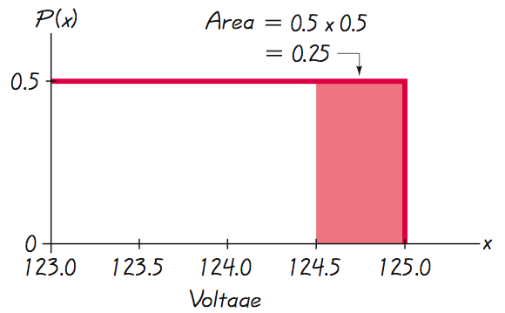
Using Area to Find Probability
Given the uniform distribution illustrated, find the probability that a randomly selected voltage level is greater than 124.5 volts.
Shaded area represents voltage levels greater than 124.5 volts.

Slide 8
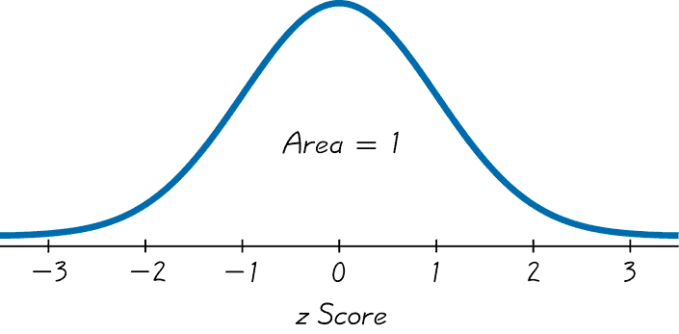
Standard Normal Distribution
The standard normal distribution is a normal probability distribution with μ = 0 and σ = 1. The total area under its density curve is equal to 1.

Slide 9
Finding Probabilities When
Given z Scores
We can find areas (probabilities) for different regions under a normal model using technology or Table A-2.
Technology is strongly recommended.

Slide 10
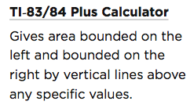
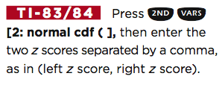
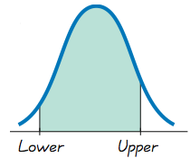
Methods for Finding Normal Distribution Areas

Slide 11
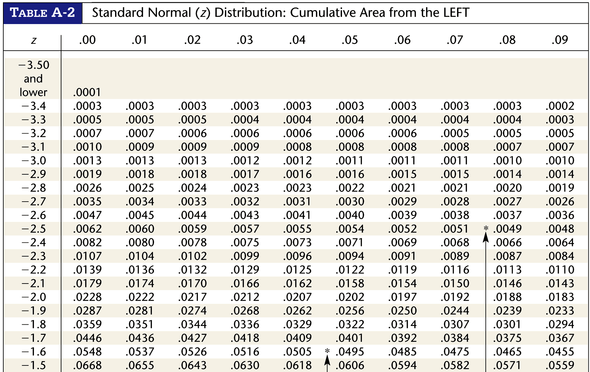
Table A-2

Slide 12
Using Table A-2
It is designed only for the standard normal distribution, which has a mean of 0 and a standard deviation of 1.
It is on two pages, with one page for negative z scores and the other page for positive z scores.
Each value in the body of the table is a cumulative area from the left up to a vertical boundary above a specific z score.

Slide 13
Using Table A-2
4. When working with a graph, avoid confusion between z scores and areas.
z score: Distance along horizontal scale of the standard normal distribution; refer to the leftmost column and top row of Table A-2.
Area: Region under the curve; refer to the values in the body of Table A-2.
5. The part of the z score denoting hundredths is found across the top.

Slide 14
Example – Bone Density Test
A bone mineral density test can be helpful in identifying the presence of osteoporosis.
The result of the test is commonly measured as a z score, which has a normal distribution with a mean of 0 and a standard deviation of 1.
A randomly selected adult undergoes a bone density test.
Find the probability that the result is a reading less than 1.27.

Slide 15

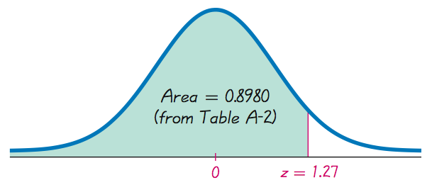
Example – continued

Slide 16
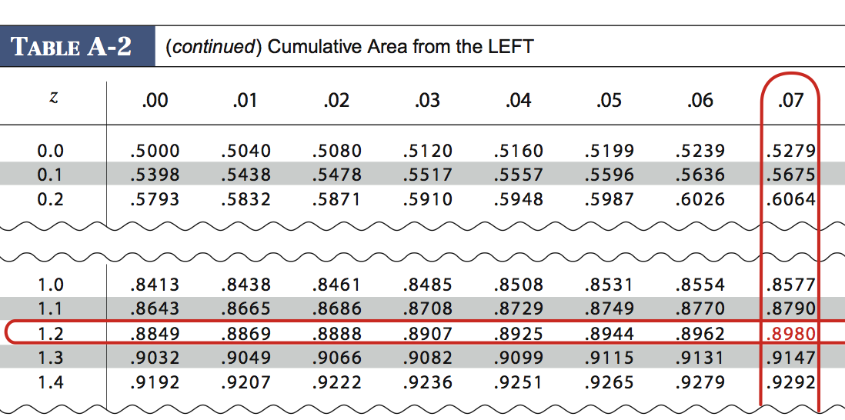
Look at Table A-2

Slide 17

Example – continued
The probability of random adult having a bone density less than 1.27 is 0.8980.

Slide 18
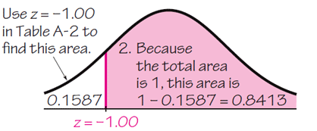
Using the same bone density test, find the probability that a randomly selected person has a result above –1.00 (which is considered to be in the “normal” range of bone density readings.
Example – continued
The probability of a randomly selected adult having a bone density above –1 is 0.8413.

Slide 19
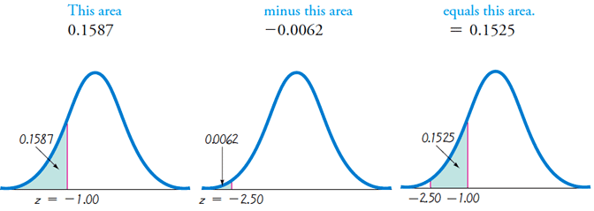
A bone density reading between –1.00 and –2.50 indicates the subject has osteopenia. Find this probability.
1. The area to the left of z = –2.50 is 0.0062.
2. The area to the left of z = –1.00 is 0.1587.
3. The area between z = –2.50 and z = –1.00 is the difference between the areas found above.
Example – continued

Slide 20



Notation
denotes the probability that the z score is between a and b.
denotes the probability that the z score is greater than a.
denotes the probability that the z score is less than a.

Slide 21
Finding z Scores from Known Areas
1. Draw a bell-shaped curve and identify the region under the curve that corresponds to the given probability. If that region is not a cumulative region from the left, work instead with a known region that is a cumulative region from the left.
2. Using the cumulative area from the left, locate the closest probability in the body of Table A-2 and identify the corresponding z score.

Slide 22
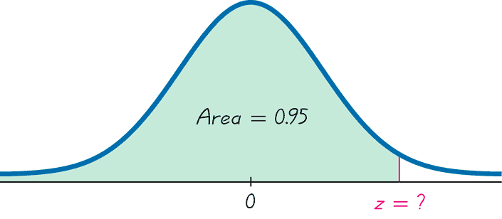
Finding z Scores
When Given Probabilities
^{5% or 0.05}
(z score will be positive)
Finding the 95th Percentile

Slide 23
Finding z Scores
When Given Probabilities
^{5% or 0.05}
(z score will be positive)
1.645
Finding the 95th Percentile

Slide 24
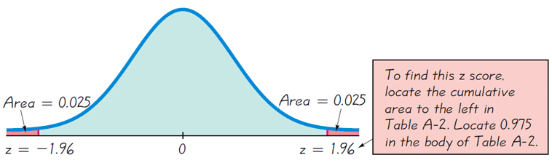
Using the same bone density test, find the bone density scores that separates the bottom 2.5% and find the score that separates the top 2.5%.
Example – continued

Slide 25
Definition
For the standard normal distribution, a critical value is a z score separating unlikely values from those that are likely to occur.
Notation: The expression z_{α} denotes the z score withan area of α to its right.

Slide 26
Example
Find the value of z_{0.025}.
The notation z_{0.025} is used to represent the z score with an area of 0.025 to its right.
Referring back to the bone density example,
z_{0.025} = 1.96.

